Slide 1
Socket 编程

Slide 2
Socket programming
Goal: learn how to build client/server application that communicate using sockets
Socket API
introduced in BSD4.1 UNIX, 1981
explicitly created, used, released by apps
client/server paradigm
two types of transport service via socket API:
unreliable datagram
reliable, byte stream-oriented
socket
a host-local,
application-created,
OS-controlled interface (a “door”) into which
application process can both send and
receive messages to/from another application process

Slide 3
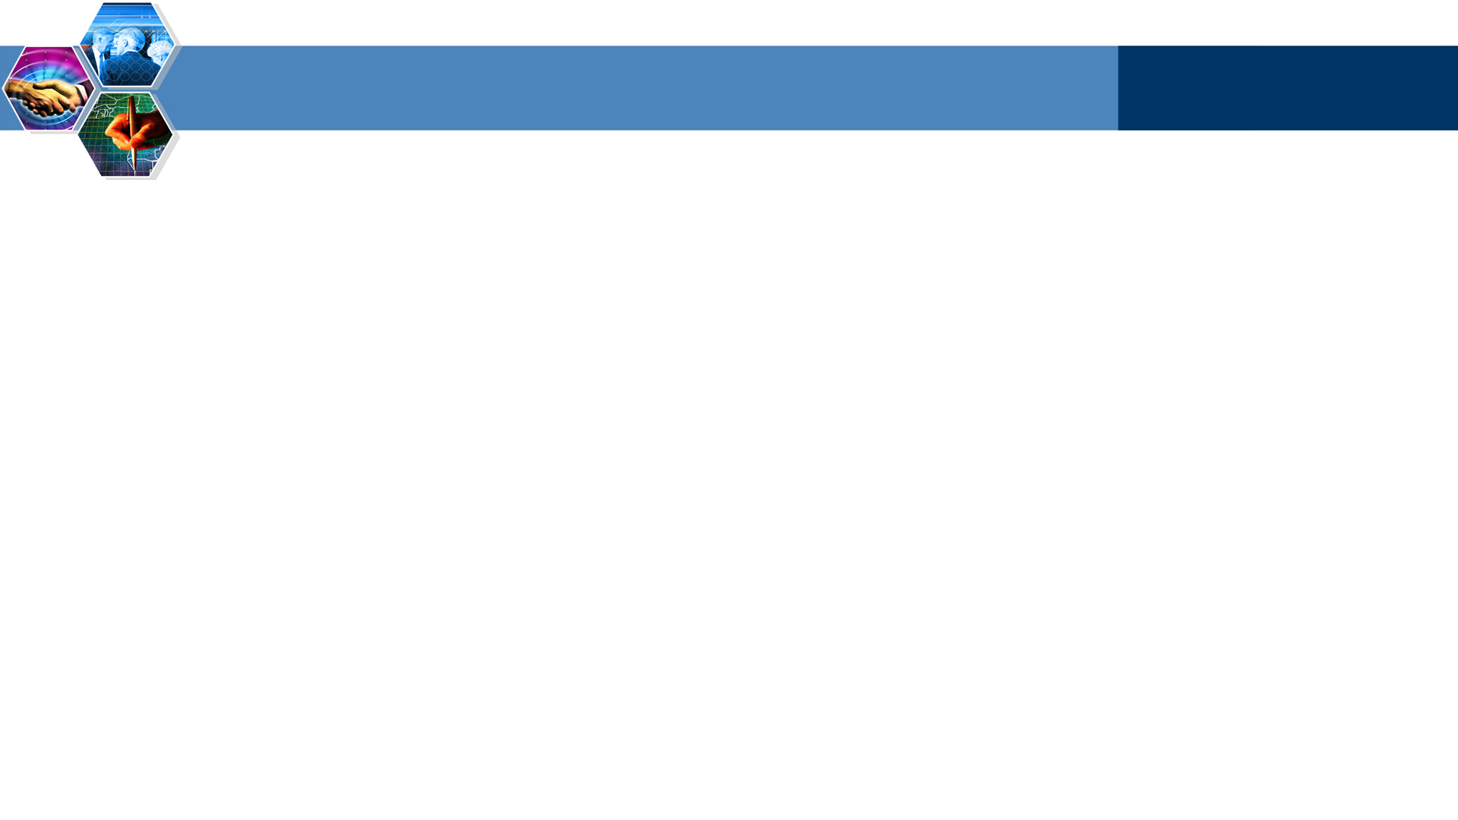
Socket-programming using TCP
Socket: a door between application process and end-end-transport protocol (UCP or TCP)
TCP service: reliable transfer of bytes from one process to another
controlled by
application
developer
controlled by
application
developer
process
process
socket
socket
TCP with
buffers,
variables
controlled by
operating
system
controlled by
operating
system
TCP with
buffers,
variables
internet
host or
server
host or
server

Slide 4
Socket programming with TCP
Client must contact server
server process must first be running
server must have created socket (door) that welcomes client’s contact
Client contacts server by:
creating client-local TCP socket
specifying IP address, port number of server process
When client creates socket: client TCP establishes connection to server TCP
When contacted by client, server TCP creates new socket for server process to communicate with client
allows server to talk with multiple clients
source port numbers used to distinguish clients
application viewpoint
TCP provides reliable, in-order
transfer of bytes (“pipe”)
between client and server

Slide 5
Client/server socket interaction: TCP
create socket,
port=x, for
incoming request:
welcomeSocket =
ServerSocket()
TCP
connection setup
wait for incoming
connection request
create socket,
connect to hostid, port=x
connectionSocket =
welcomeSocket.accept()
clientSocket =
Socket()
send request using
clientSocket
read request from
connectionSocket
write reply to
connectionSocket
read reply from
clientSocket
close
connectionSocket
close
clientSocket

Slide 6
Stream jargon
A stream is a sequence of characters that flow into or out of a process.
An input stream is attached to some input source for the process, e.g., keyboard or socket.
An output stream is attached to an output source, e.g., monitor or socket.

Slide 7
Socket programming with UDP
UDP: no “connection” between client and server
no handshaking
sender explicitly attaches IP address and port of destination to each packet
server must extract IP address, port of sender from received packet
UDP: transmitted data may be received out of order, or lost
application viewpoint
UDP provides unreliable transfer
of groups of bytes (“datagrams”)
between client and server

Slide 8
Client/server socket interaction: UDP
Server (running on host id)
create socket,
Client
create socket,
port= x.
clientSocket =
DatagramSocket()
serverSocket =
DatagramSocket()
Create datagram with server IP and port=x; send datagram via clientSocket
read datagram from
serverSocket
write reply to
serverSocket
specifying client address,
port number
read datagram from
clientSocket
close
clientSocket

Slide 9
Example: Java client (UDP)
Input: receives packet (recall that TCP received “byte stream”)
Client
process
Output: sends packet (recall
that TCP sent “byte stream”)
client UDP socket

Slide 10

Summary
Socket programming with TCP
Socket programming with UDP

